Slide 1
Blastpoint Loan Approval Project
Jared Andrews

Slide 2
Project Context
Goal: Develop an ML model to automate the loan approval process for new applicants
Provided Data
Application data for every loan approved between 10/6/2010 and 4/17/2011
Binary indicator signifying loan performance (i.e., ‘Good’ or ‘Bad’)
High-level Modeling Approach
Binary classification task
Training:
Input features: Application data
Target feature: Loan performance indicator
Online Prediction:
Output: Binary output indicating if a specific loan should or shouldn’t be approved

Slide 3
Model Performance Metrics
Assumption: absolute accuracy is not the primary performance metric
Given imbalanced training data, accuracy can be potentially maximized by always predicting the majority label (given scale of imbalance)
Consider F1-score/AUC-score evaluation metrics
Assumption: Better to miss approving a good loan than approving a bad loan
Minimize false positives
Consider recall evaluation metric
The proportion of all bad loans correctly identified
Action: Lower threshold which converts projected probability into class label
Can be individually catered based on level of risk a bank is willing to take on
Evaluation Metrics:
Accuracy, F1-score, AUC-score, recall

Slide 4
Data
Form
2 datasets provided:
Application data, Loan quality indicator data
Merge key: CustomerId
Volume (after merge)
650 samples, 33 features
Features
Customer Specific Information
General: Birth date, owns or rents residence, address zip code, email, etc.
Duration/Frequency: Residence duration, bank account duration, etc.
Credit History: Link2Credit score, FICO scores
Loan Specific Information:
Amount requested, payment frequency, loan duration, application submit date, etc.
Notes/Limitations:
Application data contains only approved loans
Skews real distribution of good/bad loans
Imperfect merge of provided data
CustomerId not unique in loan indicator data
3 instances where same customer had at least one bad loan and at least one good loan
Small sample size
No data dictionary provided
No macro-economic factors
One loan application per customer (no repeat customers)
Intended since goal is to identify if a new applicant should be given a loan

Slide 5
Initial Preprocessing
Handling Null Values
other_phone_type: 291 nulls → drop feature
payment_amount_approved: 22 nulls → drop feature (not present in production data)
how_use_money: 2 nulls → drop null rows
bank_account_duration: 1 null → drop null row
Handling of Categorical Features Represented Numerically
Cast int as string
Features: address_zip, bank_routing_number
Handling Boolean Values
Encode T/F, Y/N, Good/Bad as 1/0
Features: residence_rent_or_own, bank_account_direct_deposit, payment_ach
Credit Score Based Filtering
L2C and FICO credit scores range from 300-850
Remove anyone outside of predefined range -30 samples

Slide 6
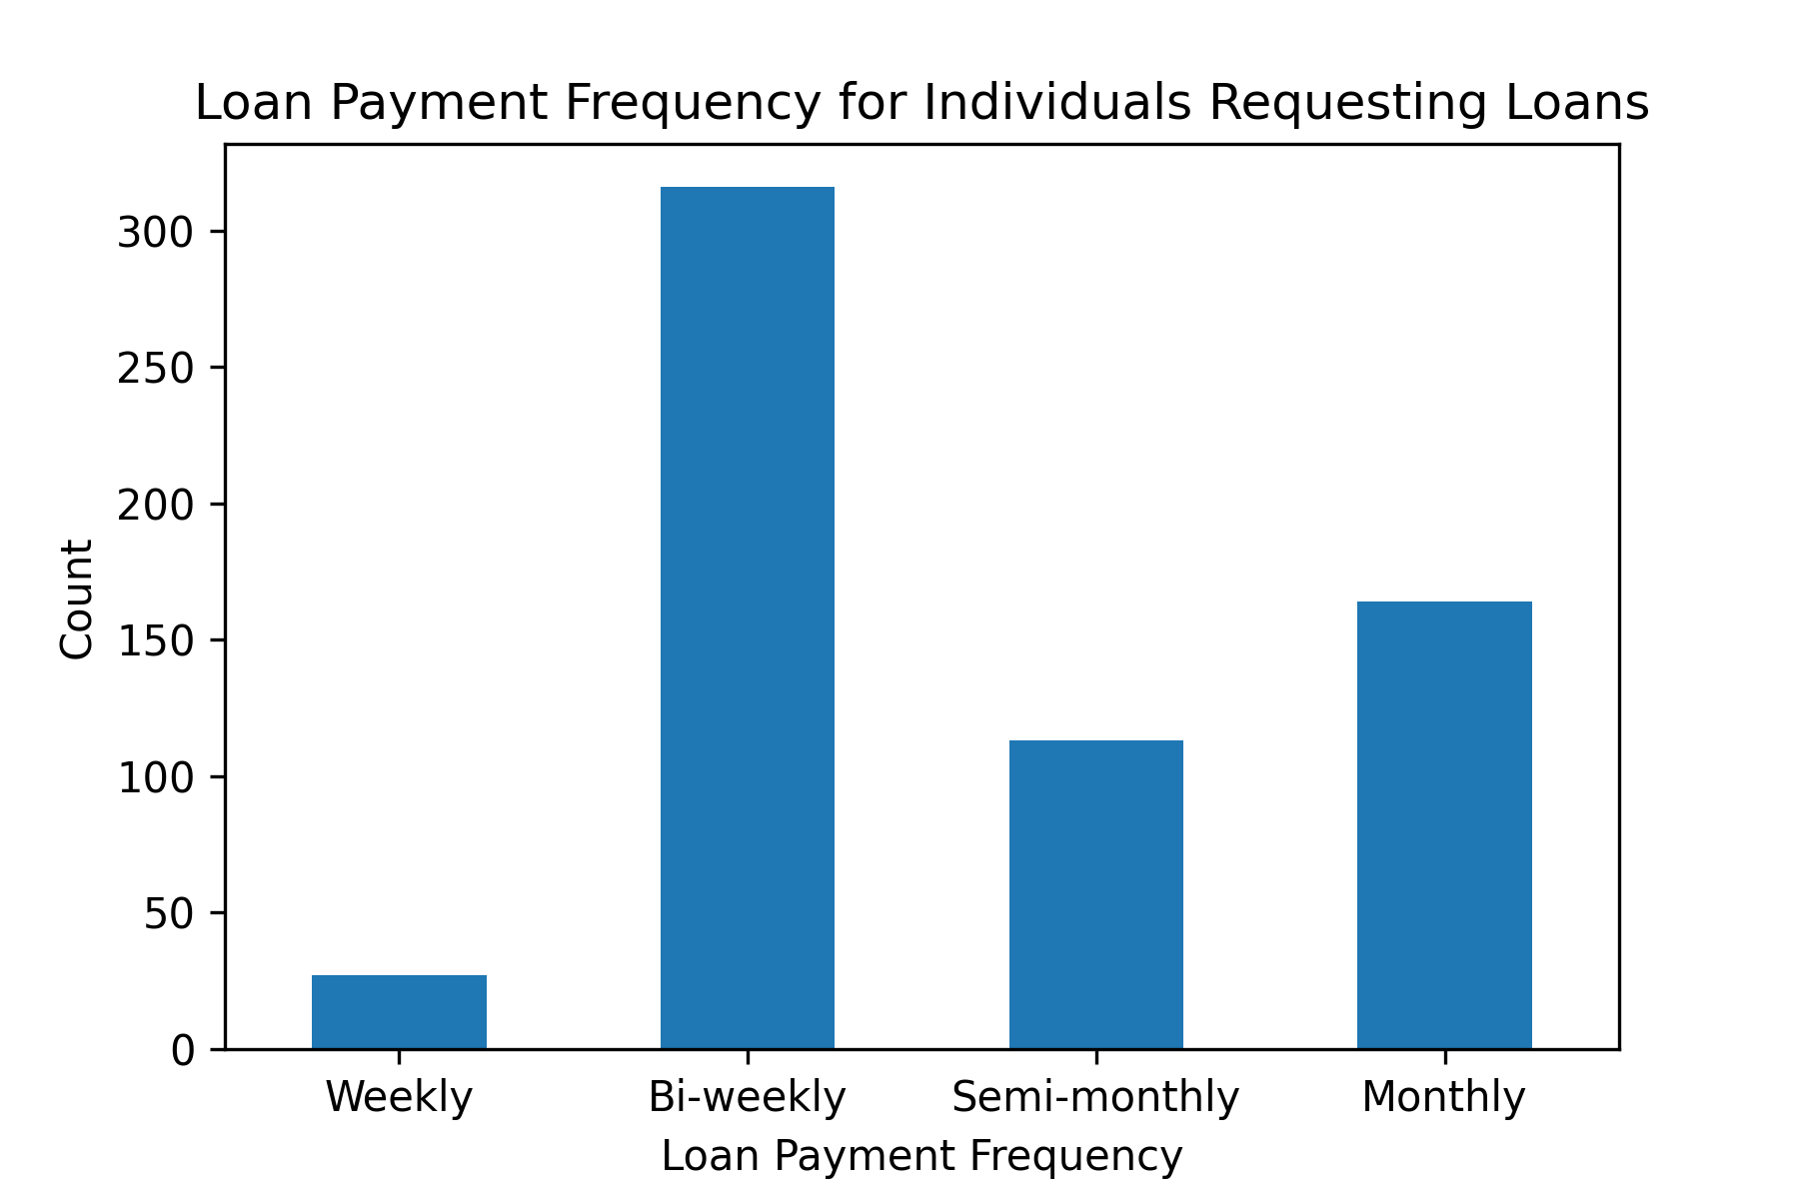
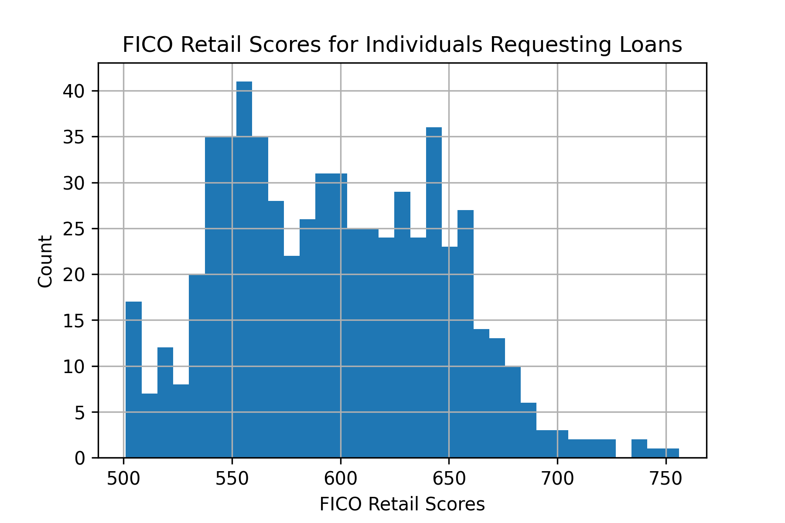
Exploratory Data Analysis- Univariate
Purpose: Get overall feel for features – possible values, variance, mean, mode
Gives intuition into feature engineering and feature selection
Categorical Features → Value Counts, Histograms
Numeric Features → Descriptive Statistics, Histograms
Target Feature Distribution
55.3% Bad
44.7% Good

Slide 7
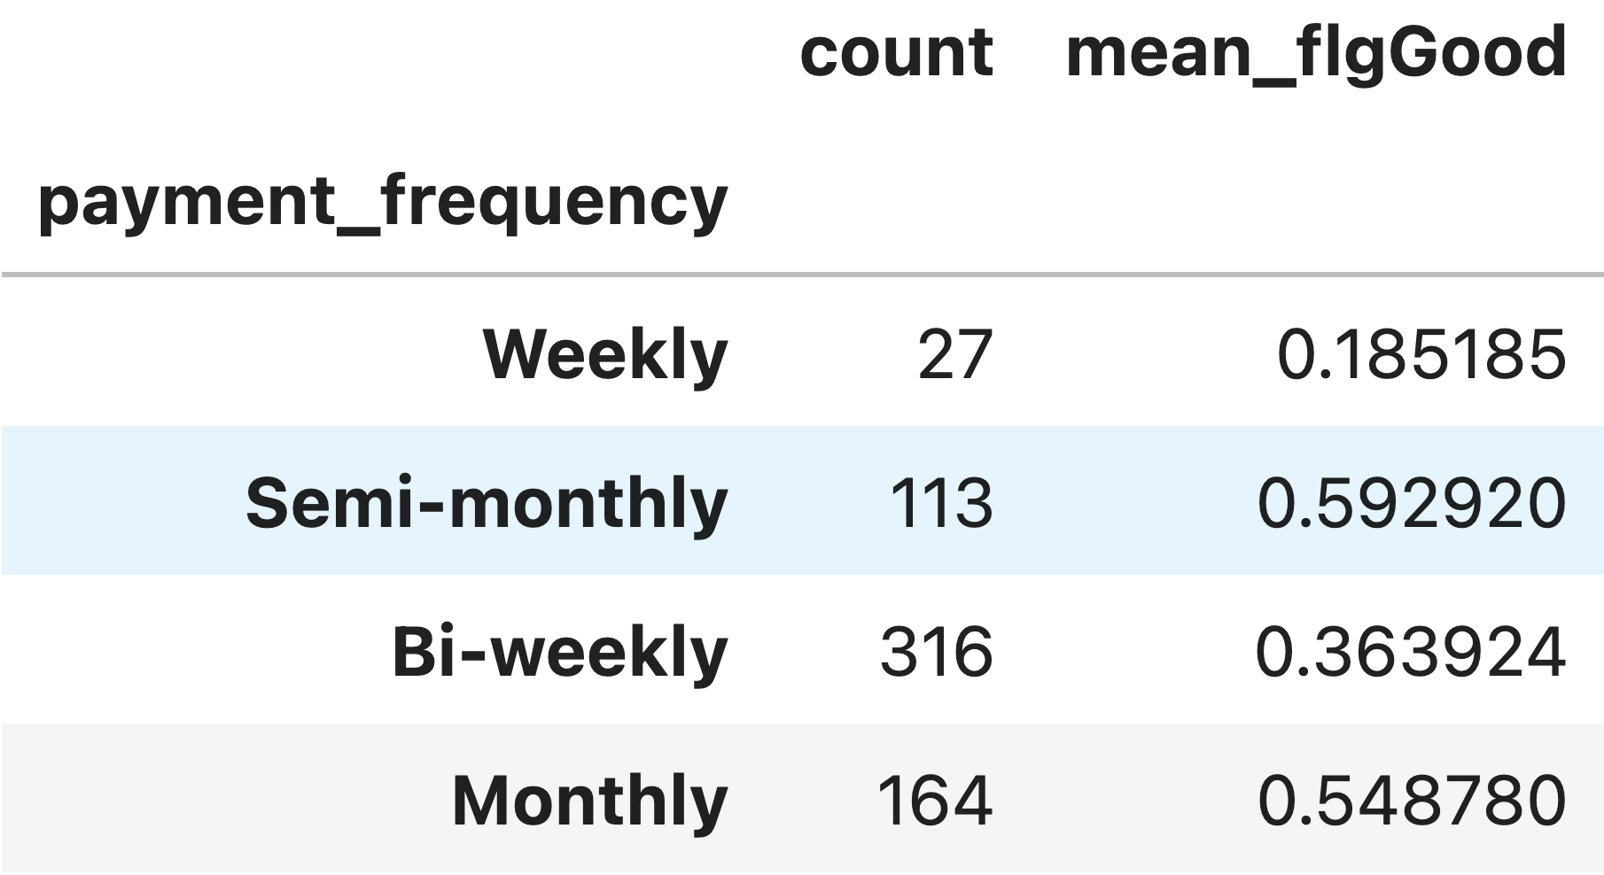
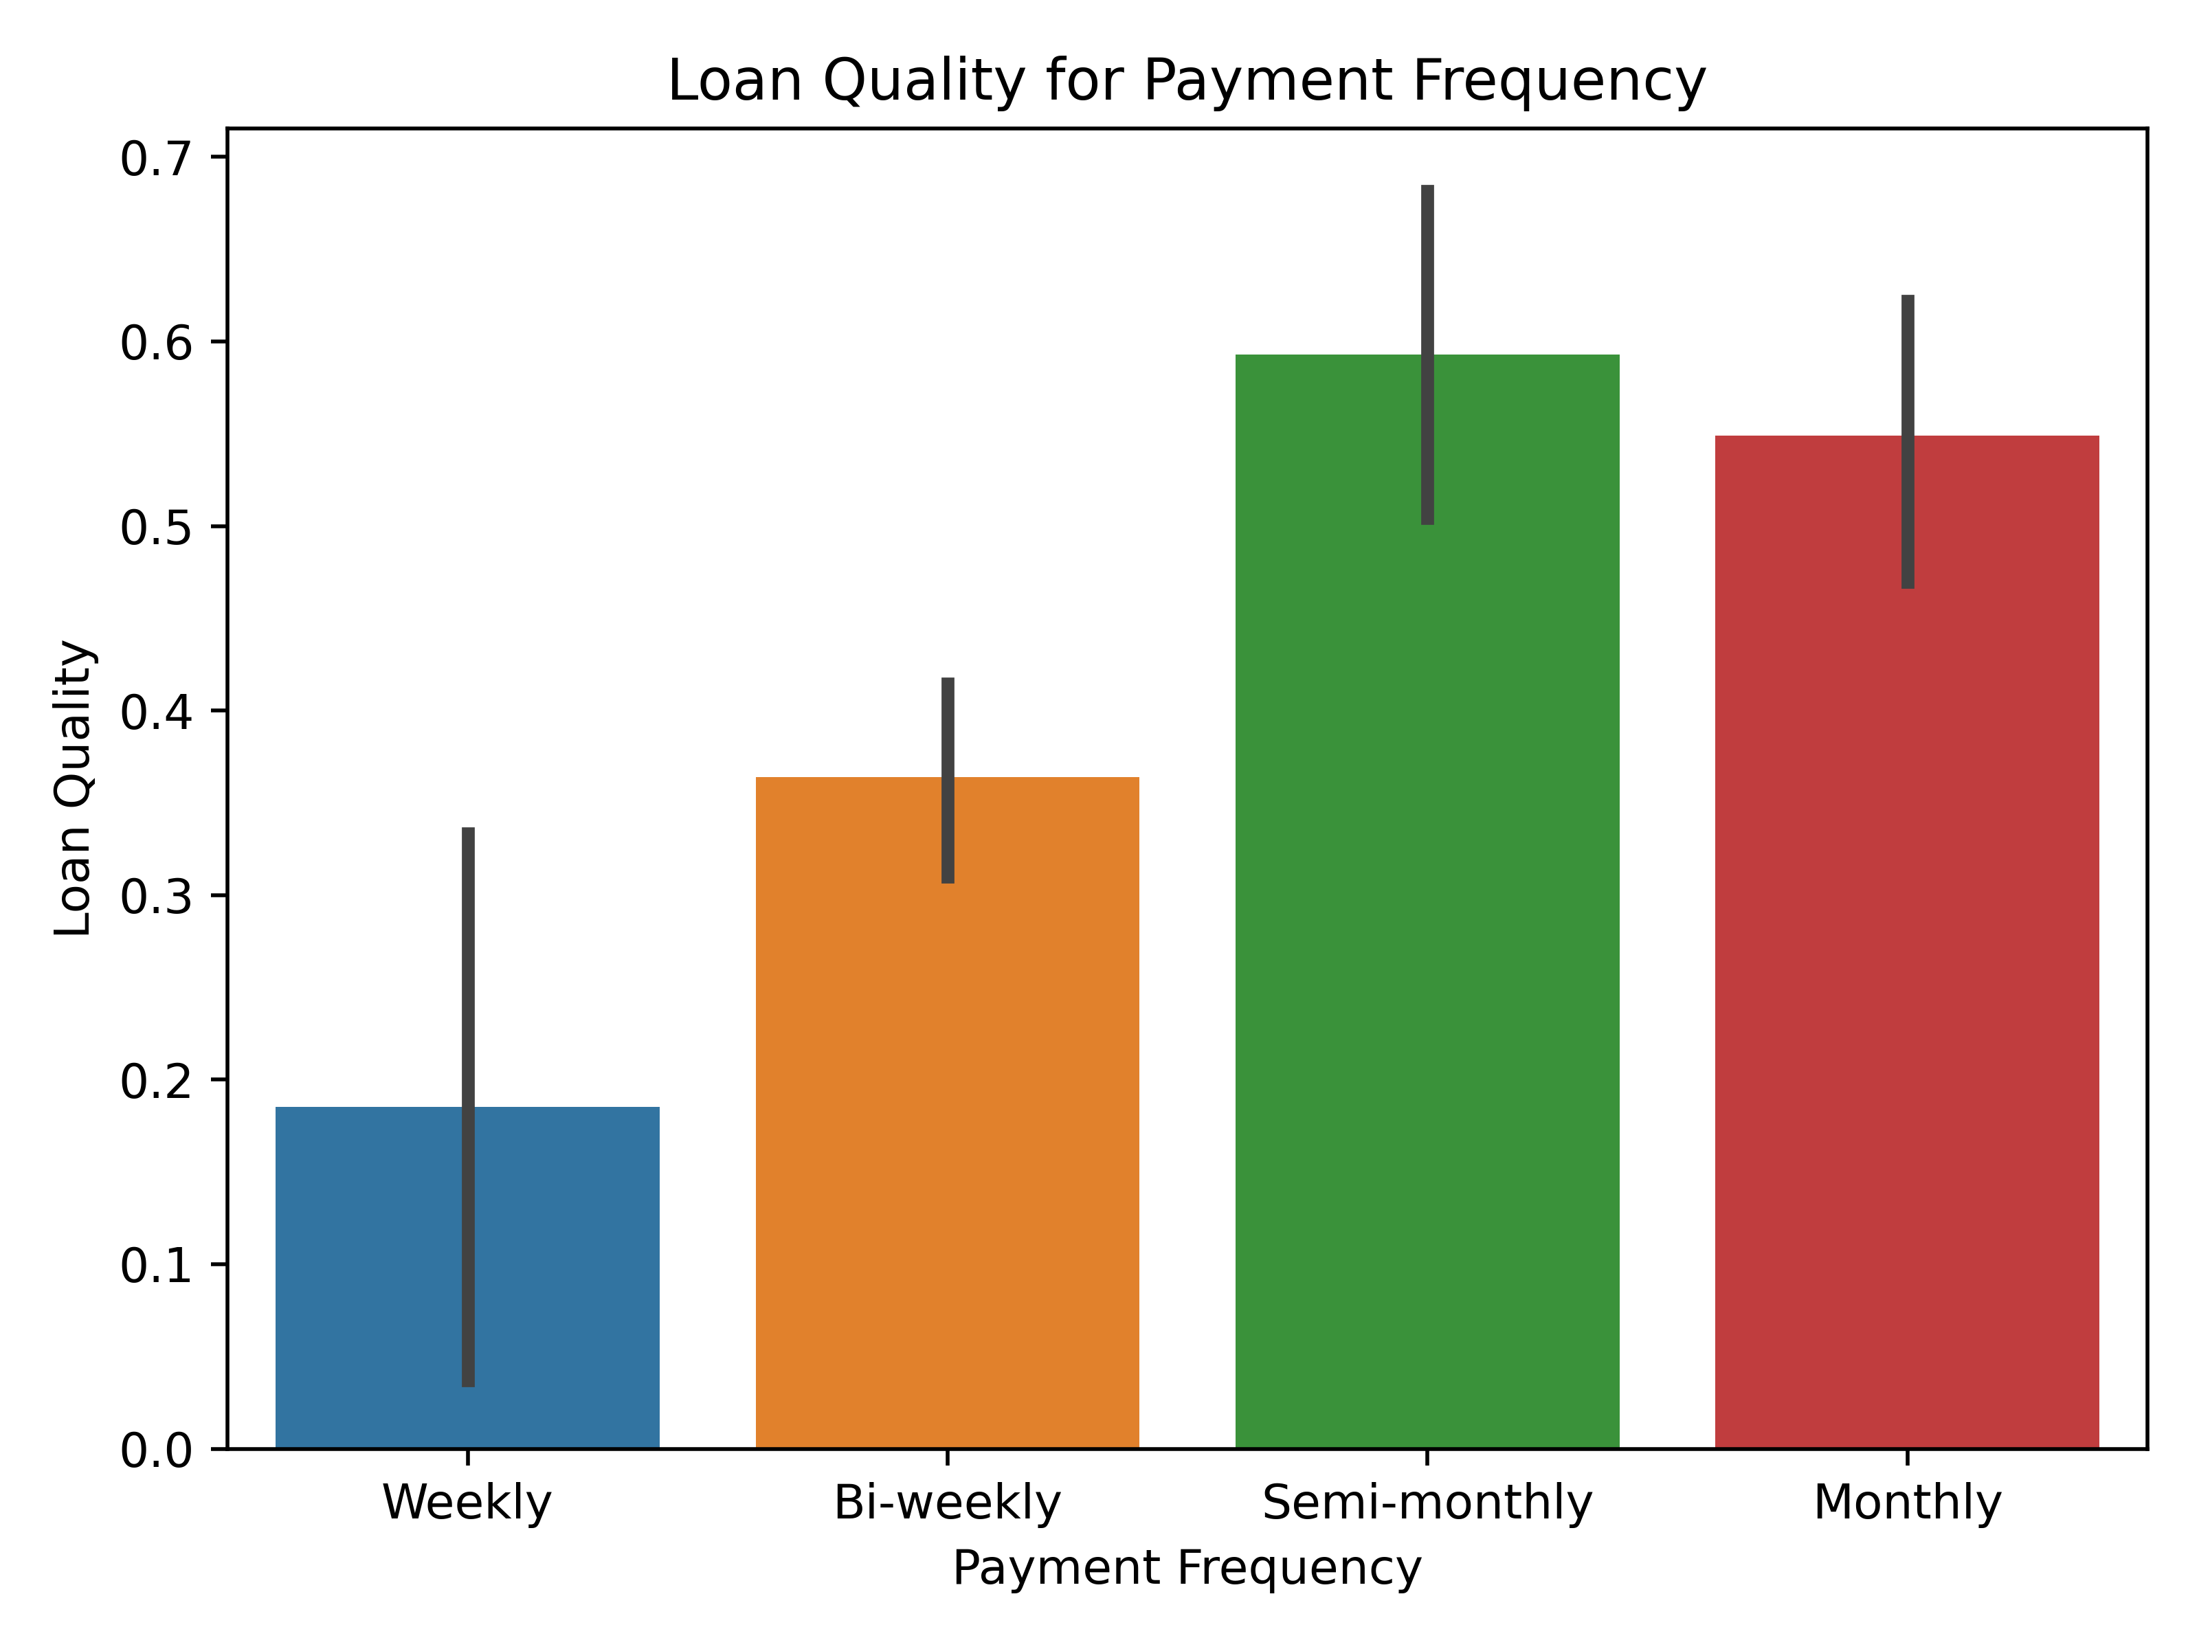
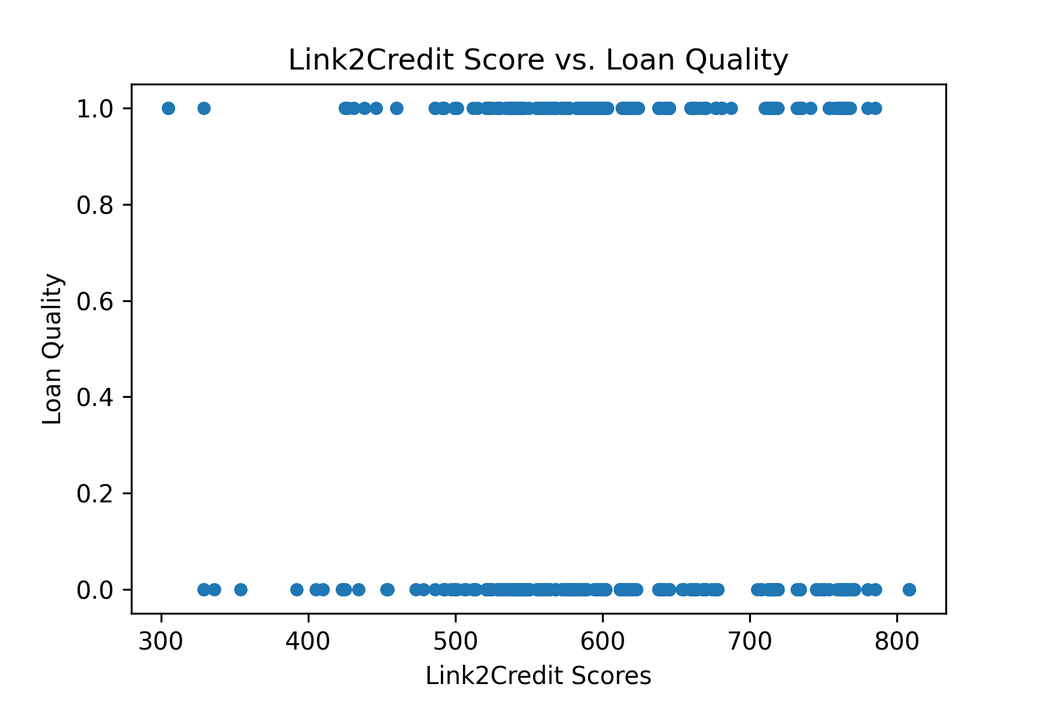
Exploratory Data Analysis- Bivariate
Purpose: See if feature may be a good predictor of loan quality
See if feature can separate good and bad loans
Categorical Features → Conditioned Value Counts, Barplots
Numeric Features → Scatter plots

Slide 8
Exploratory Data Analysis- Feature Selection
Initial round of feature selection based on univariate/bivariate analysis
Remove features with that have zero/little predictive power
Removed Features
customer_id, status, email, home_phone_type, how_use_money, idLoan, payment_ach, birth_date
birth_date: Equal Credit Opportunity Act

Slide 9
Feature Engineering
Bin categorical features
Serves to reduce the dimensionality of one-hot encoded outputs by removing low frequency values
Features:
Address zip: Keep first 2 digits of zip code; 193 -> 3 unique values
Bank routing number: Keep high frequency BRNs, move others into ‘default’ category; 130 -> 9 unique values
Duration features: Create category of ‘0-12 months’ (previous ‘months’ values were very low frequency)
Creation of new features
pays_rent: boolean feature indicating if the loanee pays rent
monthly_income_after_rent: feature capturing income level after paying rent
Base Feature Set
amount_requested, monthly_income_after_rent, residence_rent_or_own, bank_account_direct_deposit, loan_duration, num_payments, payment_amount, amount_approved, duration_approved, address_zip, bank_routing_number, email_duration, residence_duration, bank_account_duration, payment_frequency, raw_l2c_score, raw_FICO_telecom, raw_FICO_retail, raw_FICO_bank_card, raw_FICO_money, pays_rent

Slide 10
Model Training Preparation
Creation of train/test datasets
Split samples sequentially based on application submit date
Train: 80% of data, Test: 20% of data
During feature selection and hp-tuning, the training data was used to create 3-fold cross validation splits
Training sample weights
Weigh more recent samples higher
Preprocessing
One-hot-encoding of categorical features
Min/Max scaling of numeric features

Slide 11
Training Process
Perform Feature Selection
For ensemble models, feature selection wasn’t explicitly performed
For non-ensemble models, used the SFS (Sequential Forward Selection) feature selection wrapper method
Perform Hyper-parameter Tuning
Utilize Optuna (automatic hyperparameter optimization software framework)
Pruner: Hyperband
Sampler: Tree-structure Parzen Estimator (TPE)
Used training set to produce time-based 3-fold cross-validation sets
HP configuration with the highest average scoring metric across all folds was selected
Model Training
Train model using train set with the best feature set and best hyperparameters
Model Evaluation
Perform model evaluation on test set
Metrics: Accuracy, F1-Score, AUC Score, Recall
Model Explainability
Utilize native feature importance scores and SHAP values to gain insight into impact of features on the testing results
Final Model Training
Train model using all the data with the best feature set and best hyperparameters (used in “production”)
Experiment Tracking
Log and track model training artifacts/results via the Weights and Biases MLOps platform

Slide 12
Model Experimentation
Train/Tested models:
Logistic Regression
Random Forest
XGBoost
Test Results:
WeightsAndBiases Overview

Slide 13
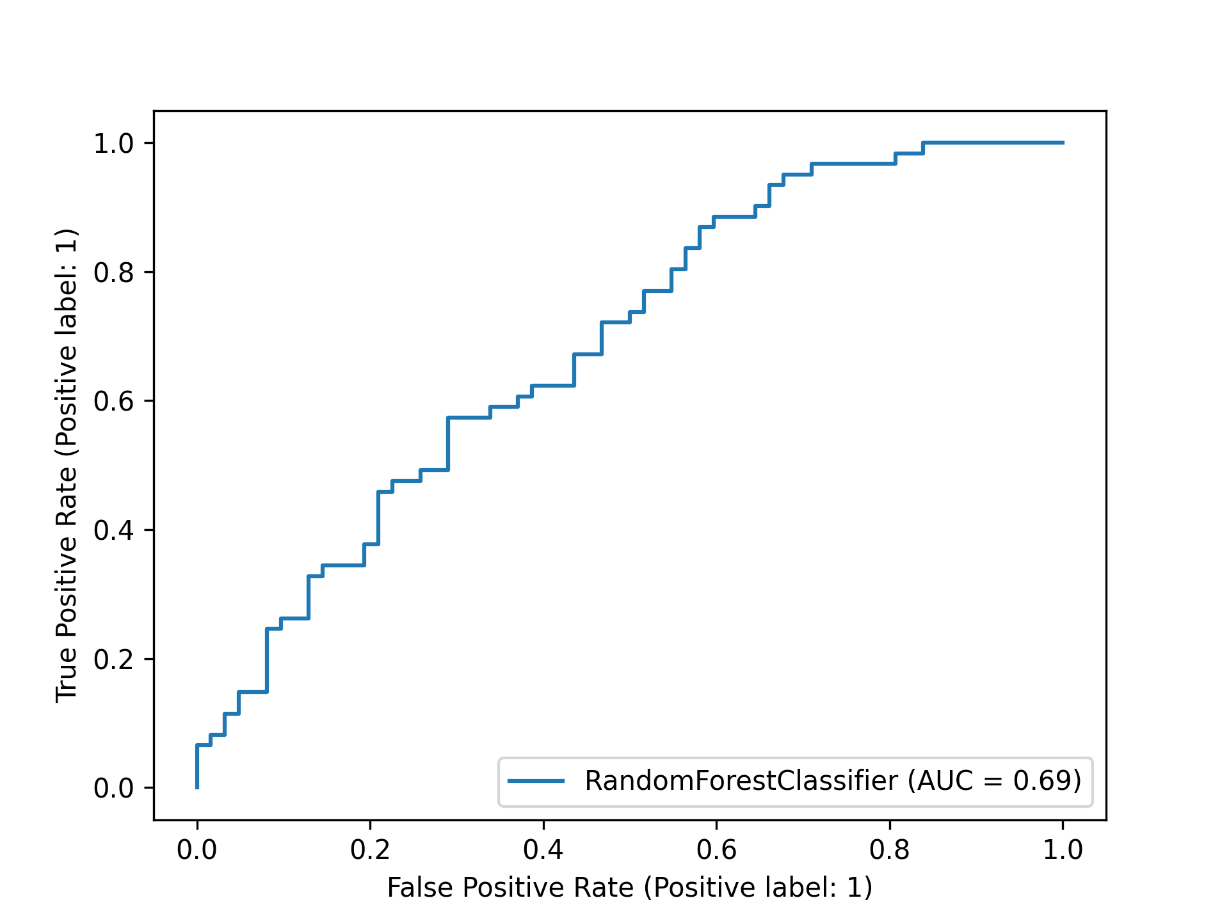
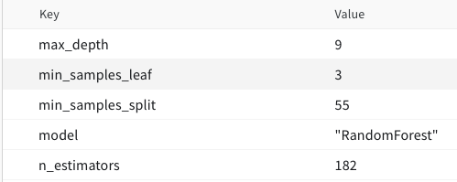
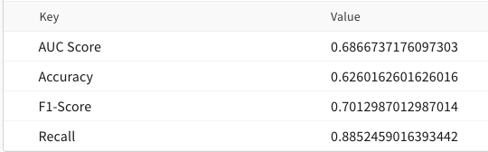
Final Model Analysis
Based on test results, the Random Forest Classifier would be chosen as the production model
Best AUC, F1 and recall scores, training efficiency
Caveat: further training improvements/more training data would likely improve XGBoost’s results when compared to RandomForest’s results
Best HP configuration:
Random Forest Testing Results:

Slide 14
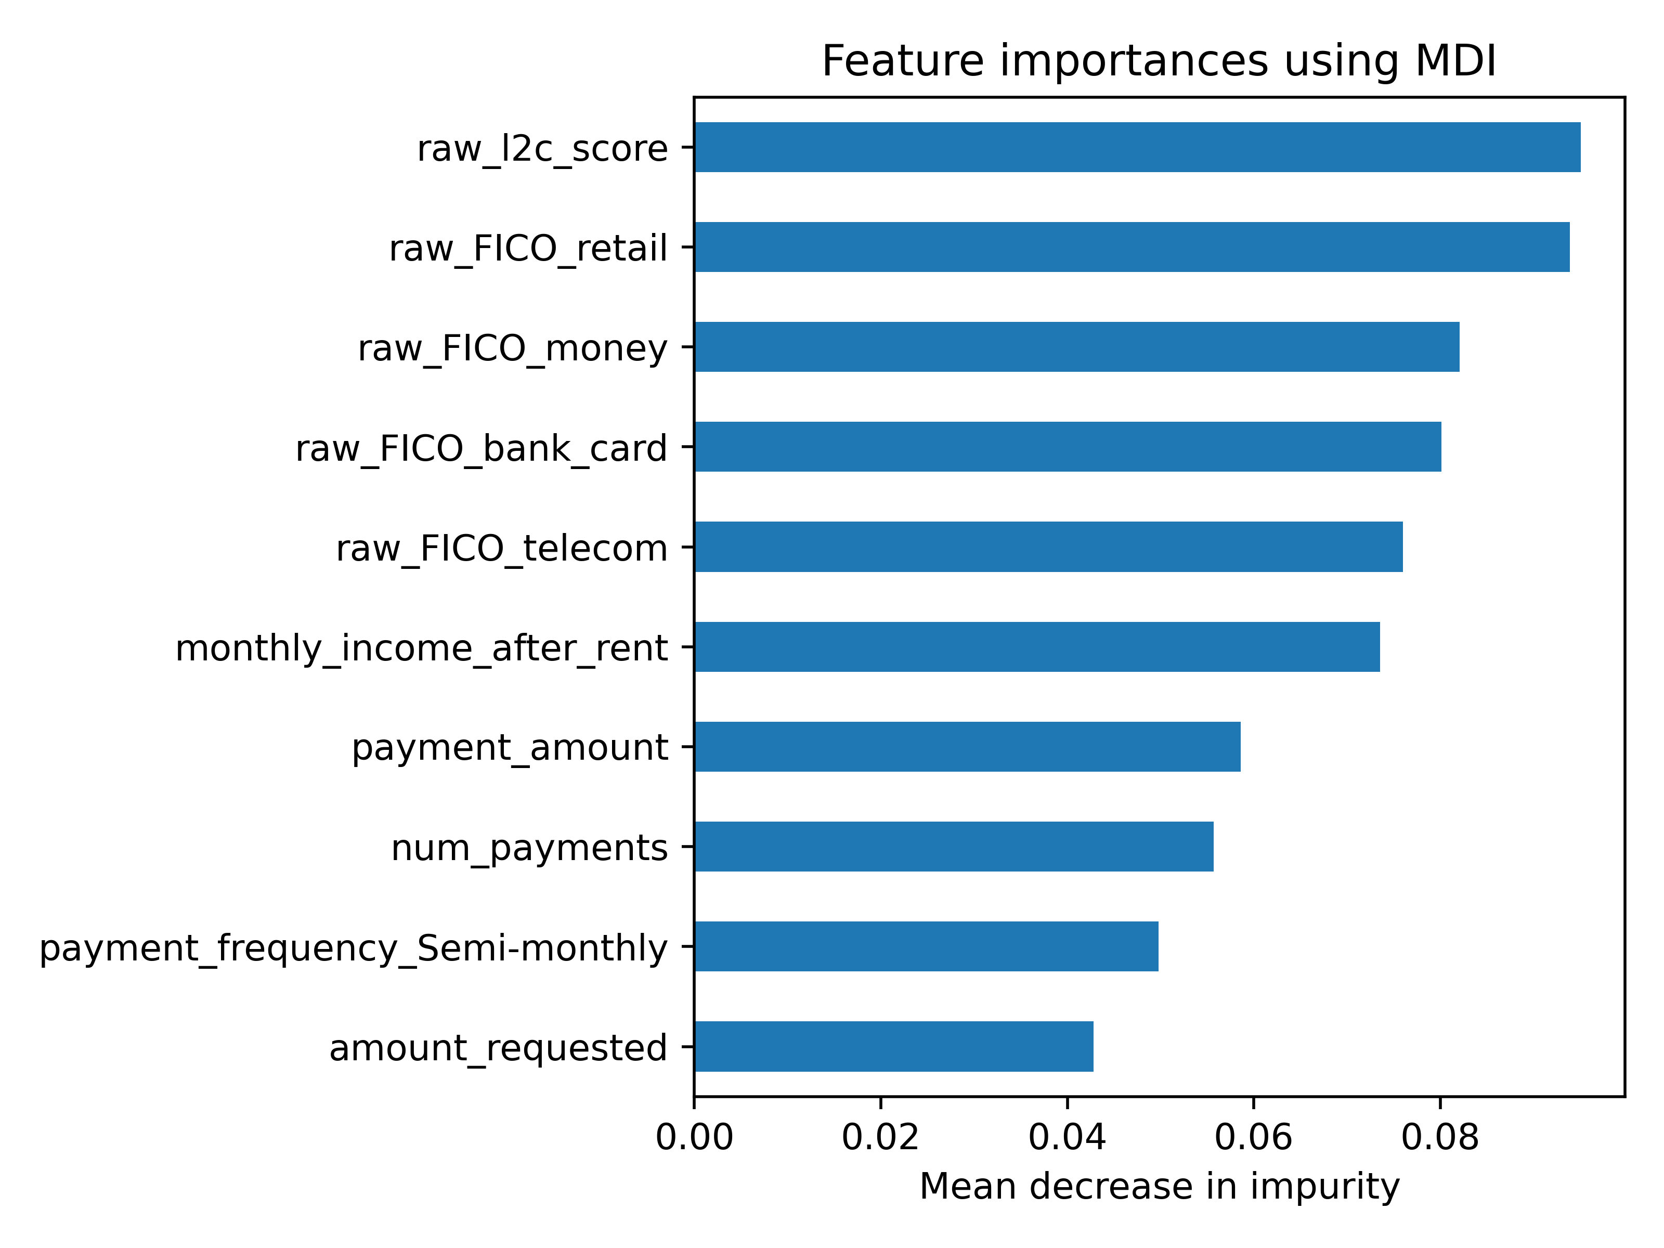
Model Explainability - Feature Importance
Calculated via RandomForest’s native feature importance score method
Utilizes “mean decrease in impurity” which quantifies how well a feature was able to split good and bad loans across all splits the feature was used in
Observations:
Important Features: credit scores, income, payment frequencies, numeric payment info
Unimportant Features: address zip codes, email durations, bank routing numbers

Slide 15
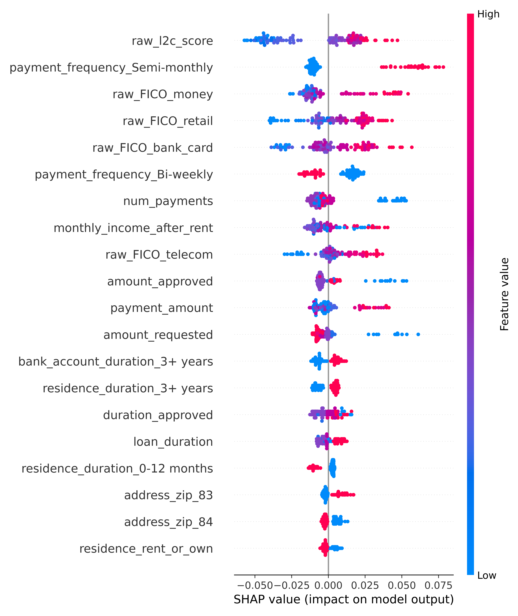
Model Explainability - SHAP Values
SHAP values encode the impact specific inputs features have on the resulting output
Based on testing data
Some observations
Higher credit scores led to higher output probabilities
Paying semi-monthly led to higher output probabilities
Higher requested amounts led to lower output probabilities
Lower number of payments led to higher output probabilities

Slide 16
preprocessed_df
Experiment Tracking
Utilized weights and biases to log/store the following training results and artifacts:
Raw, intermediate and final datasets
EDA analysis plots
Best hyperparameter configuration
Final trained model
Raw/binarized model predictions for testing dataset
Testing metrics (accuracy, F1, ROC-AUC, Recall scores)
Model analysis outputs (feature importance, ROC AUC, SHAP plots)
WeightsAndBiases Overview

Slide 17
Model Monitoring
Unable to efficiently get “ground truth” label for production data that forms the basis of typical model monitoring data
Loan repayments take many months or years
Use proxy for ground truth label
Monitor the percentage of people who have made a late payment over the past month
Dramatic increases or decreases can trigger a refresh of the model or signify the need to develop a completely new model
Monitor prediction drift
Utilize distribution distance metrics to quantify prediction drift (e.g., Kullback-Leibler Divergence, Population Stability Index (PSI))

Slide 18
Limitations/Shortcomings
Data limitations
Only contained approved loans; an actual in-production model will encounter loans that will be denied
Small sample size
No data dictionary provided
No macro-economic factors
Personal knowledge
Minimal knowledge of the lending space
Minimal research into prior loan approval ML models

Slide 19
Project Code
Project Github

